Slide 1



BIOREACTOR
Advanced Level -- July 2017

Slide 2
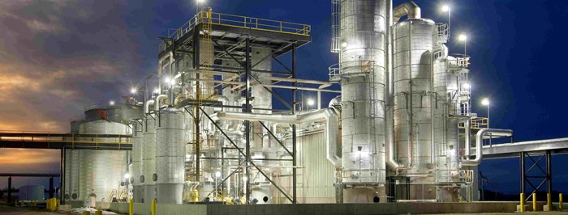
Introduction to Modern Bioreactors
Notes:
http://www.interstates.com/experience/experience-detail/18/Ethanol_Plant

Slide 3
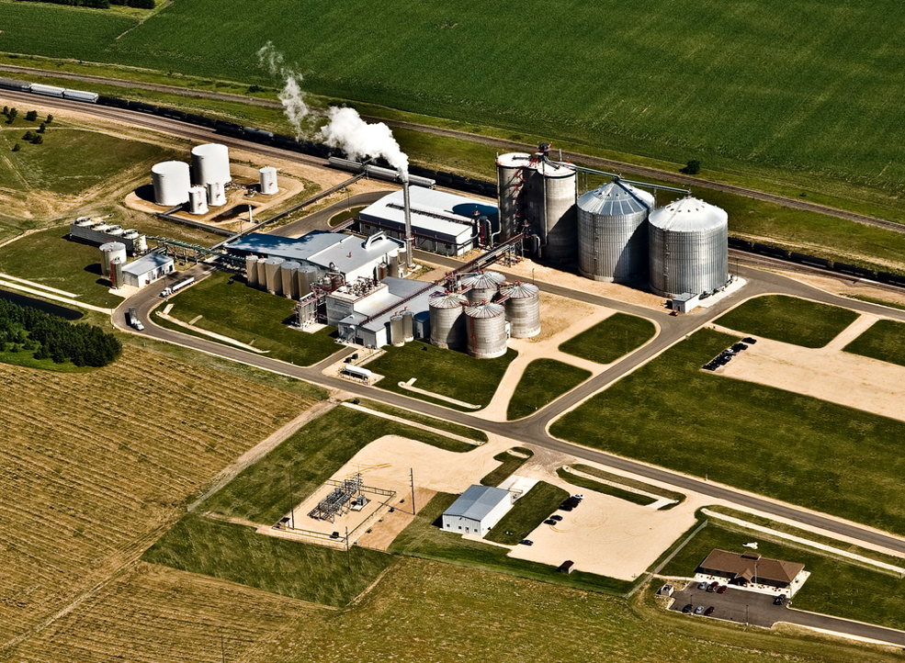
Ethanol plants are complex and it is not obvious what function each component serves
Notes:
http://ethanolproducer.com/articles/7963/western-wisconsin-energy-55-mmgy-ethanol-plant-up-for-grabs

Slide 4
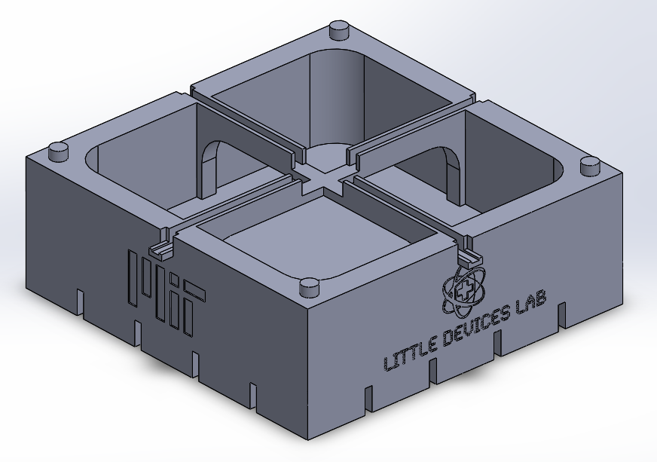
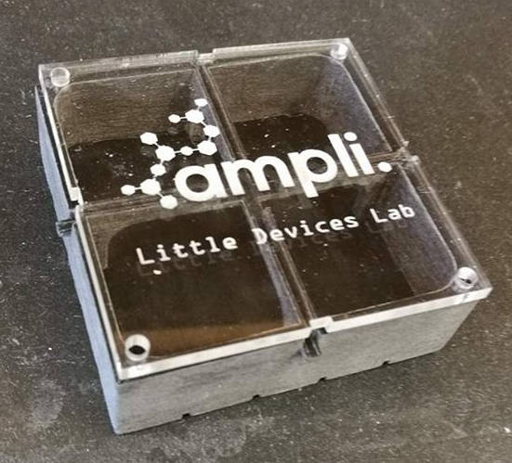
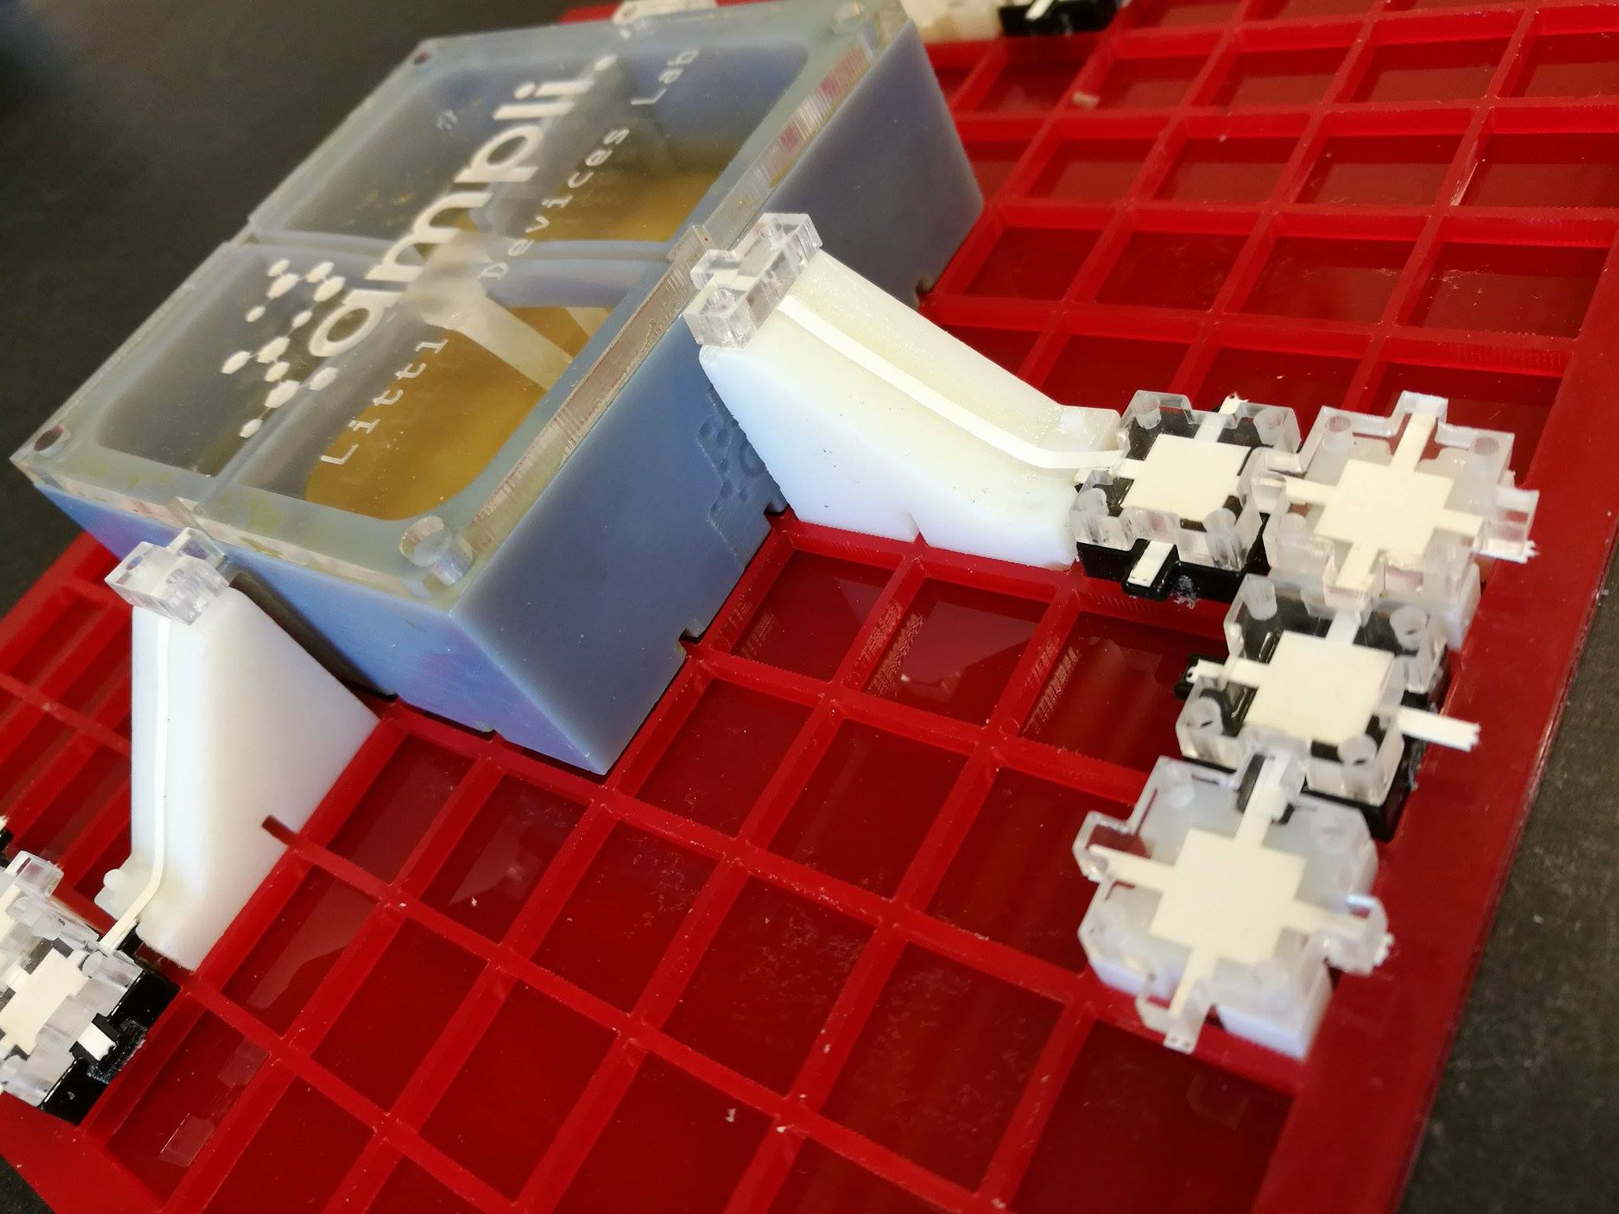
The Ampli Bioreactor
Notes:
Kept weird photo for presentation

Slide 5
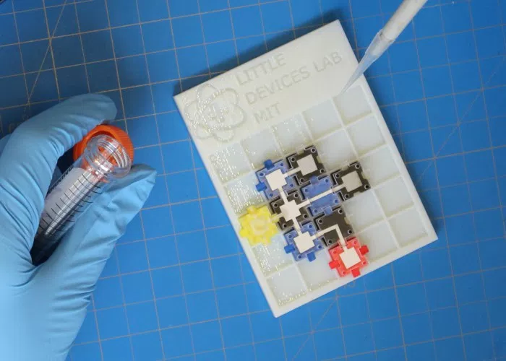
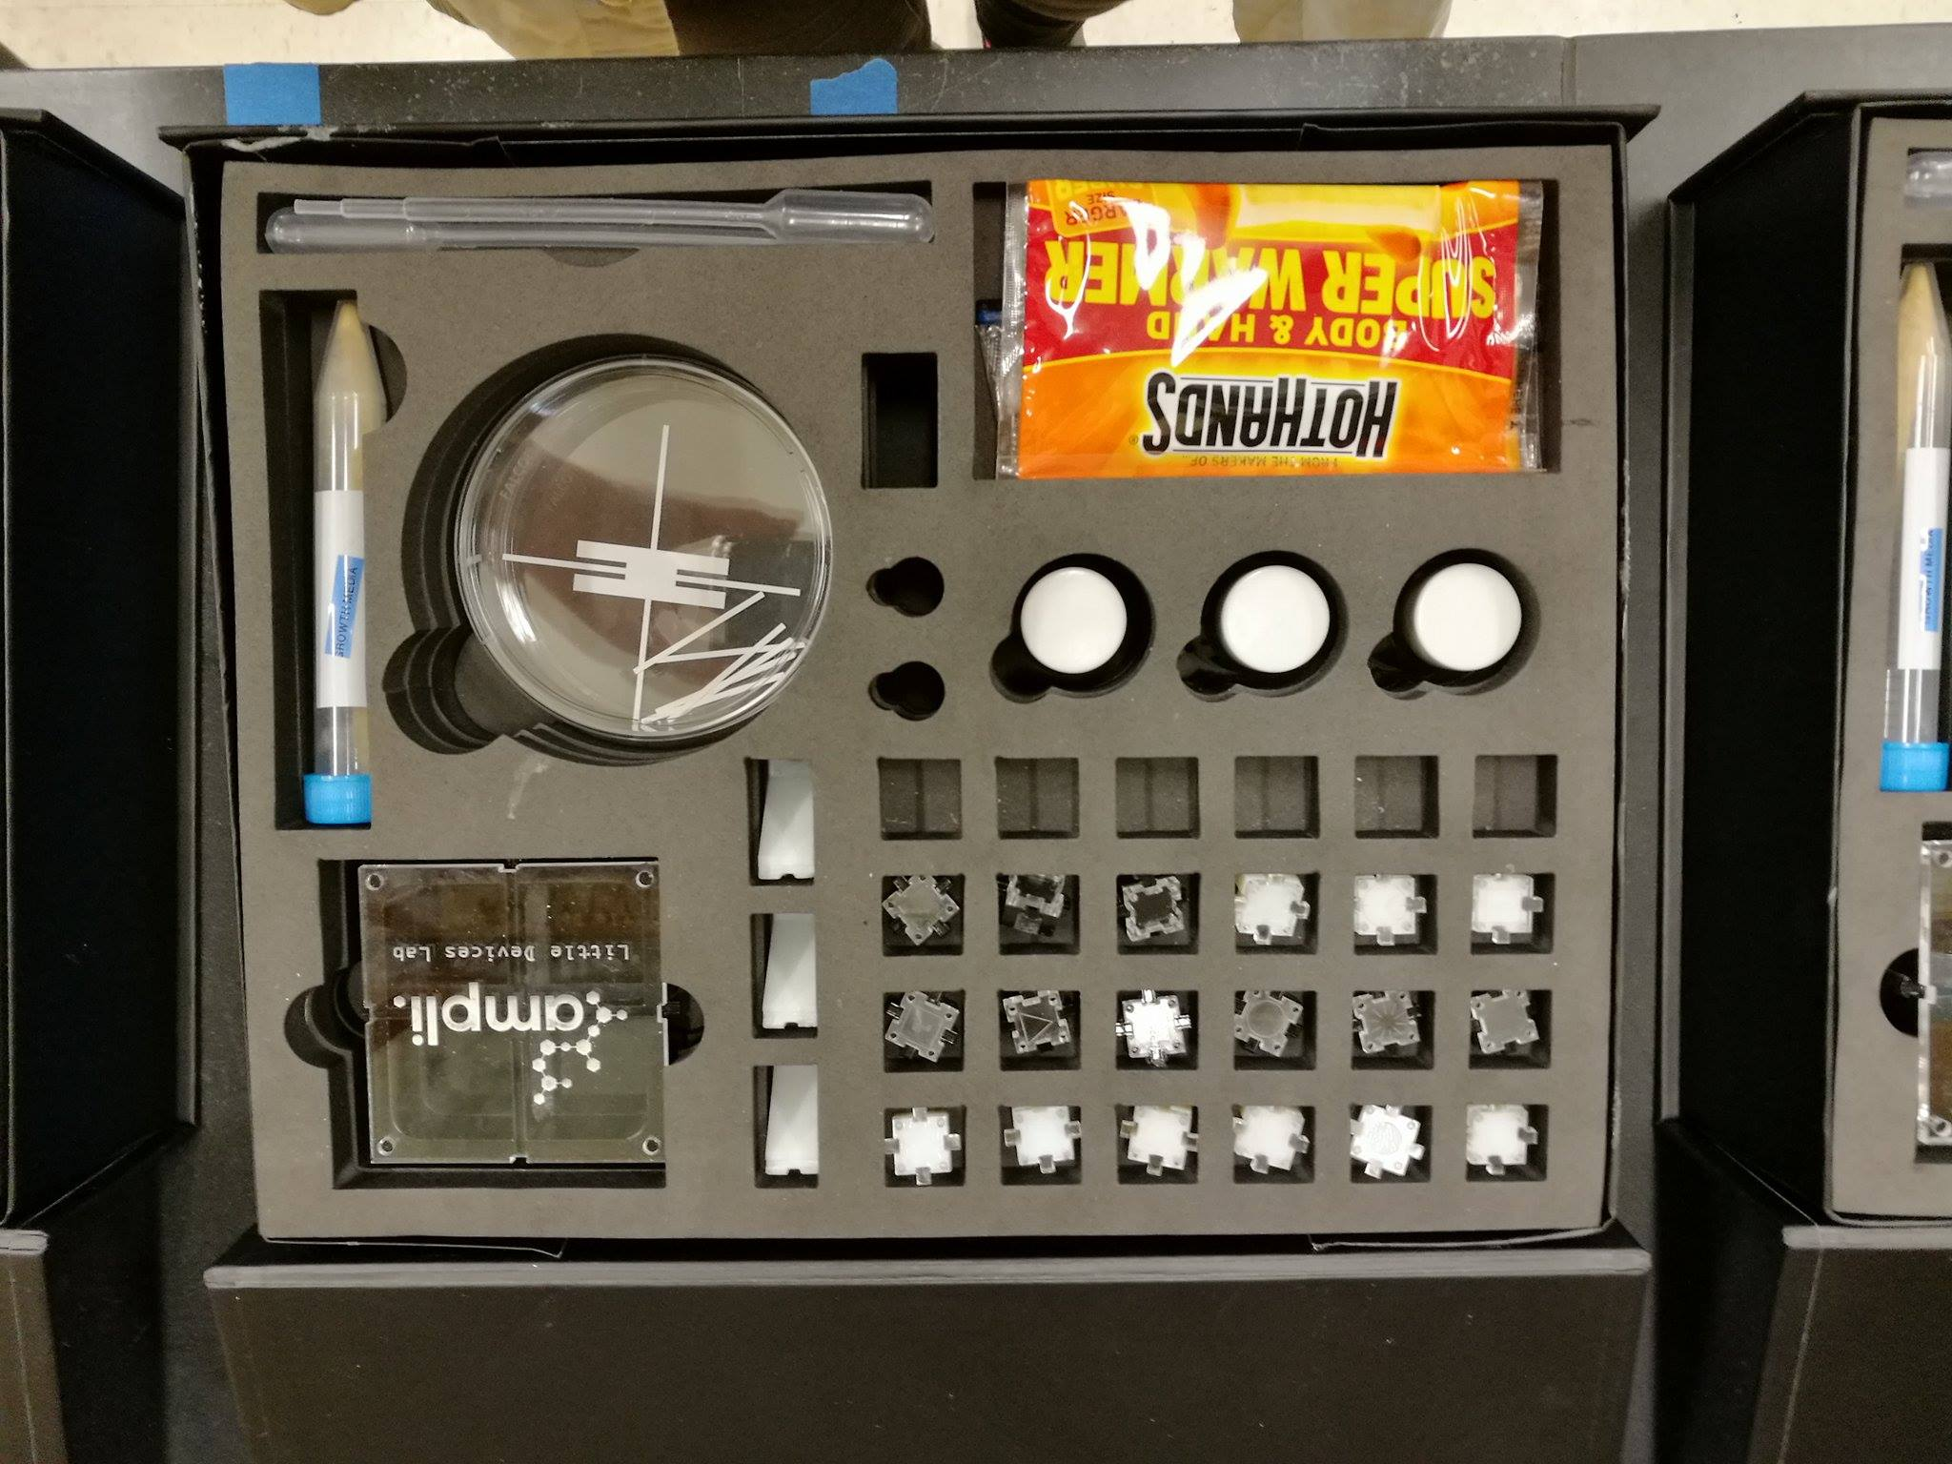
Ampli chemical circuit
Ampli biochemistry kit

Slide 6
Ampli Bioreactor
Advanced Level
BIOREACTOR

Slide 7
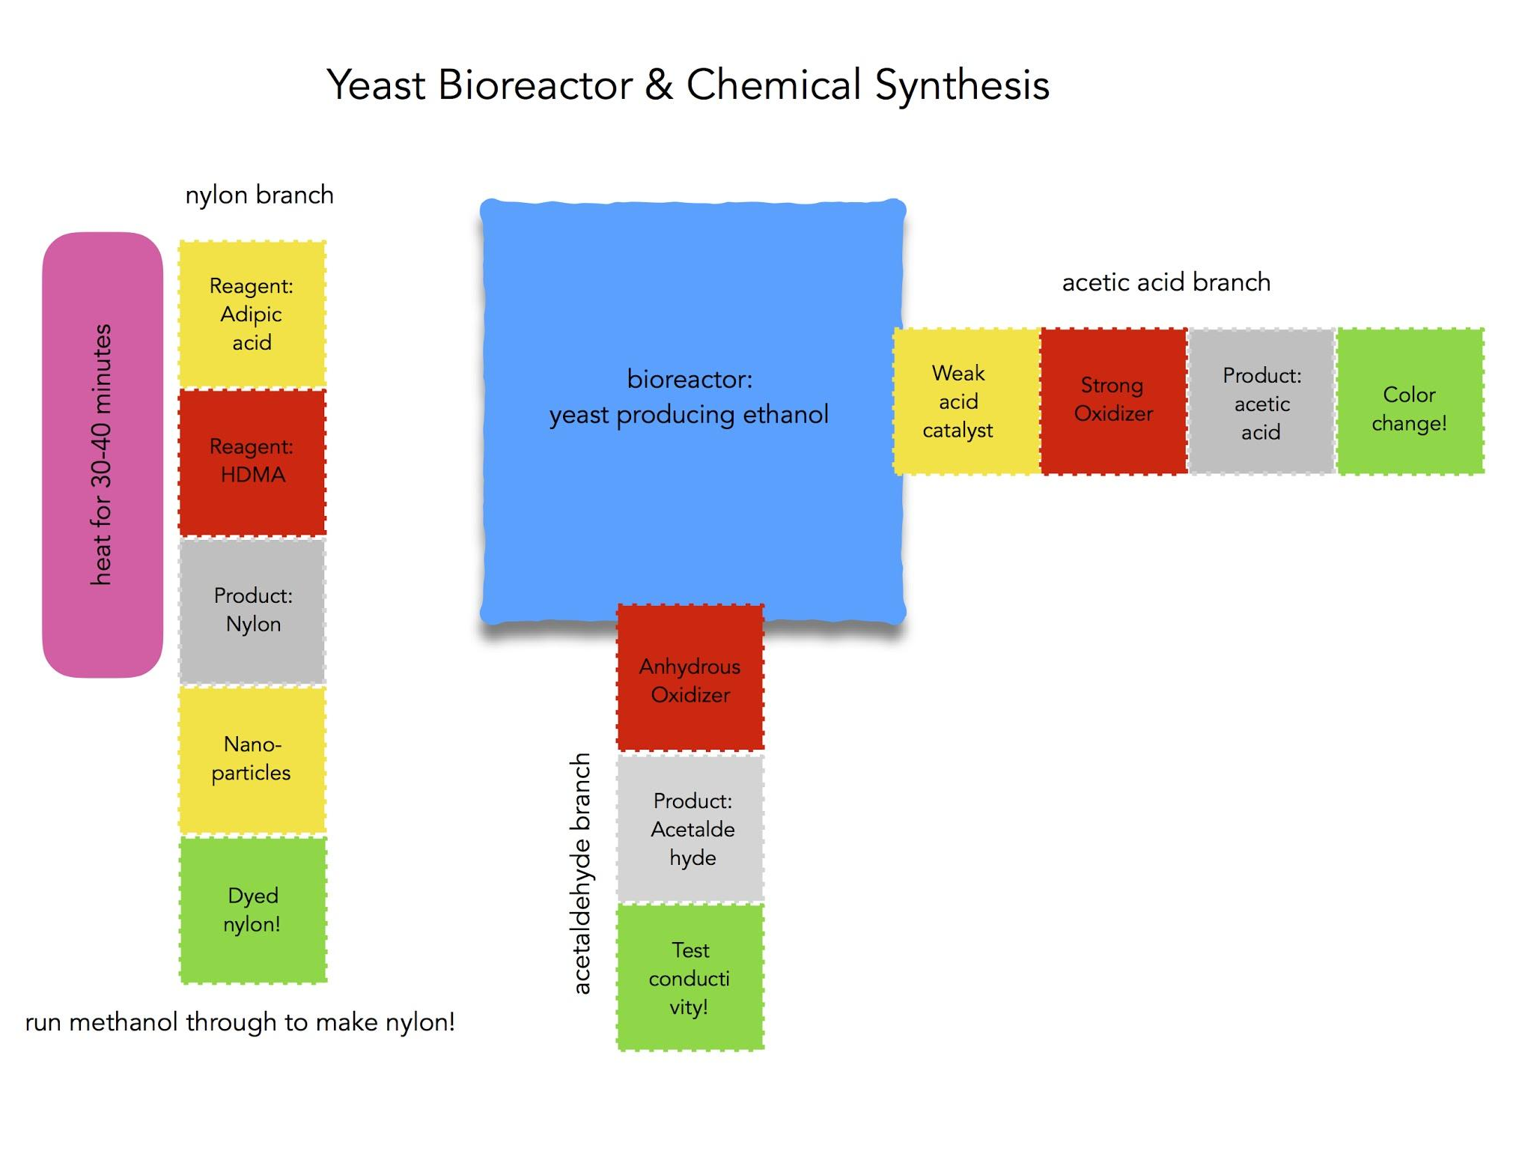
Advanced Level Ampli activities:
Chemical Reaction Circuit:
Set up a linear chemical reaction
Employ heating and pipetting elements
Discover uses of nanoparticles
Create nylon polymers!
Organic Synthesis using Bioreactor Products:
Evaluate fermentation success
Use bioreactor ethanol in multiple simultaneous chemical reactions
Carry out organic synthesis of ethanol derivatives
Evaluate products with pH, conductivity, and more!

Slide 8
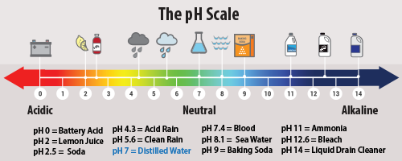
Chemical Circuit Design -- what can you design using food coloring, pH detection, and a mild acid?l
Notes:
Flow and pH experiments

Slide 9
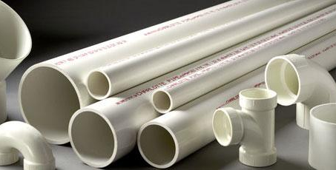

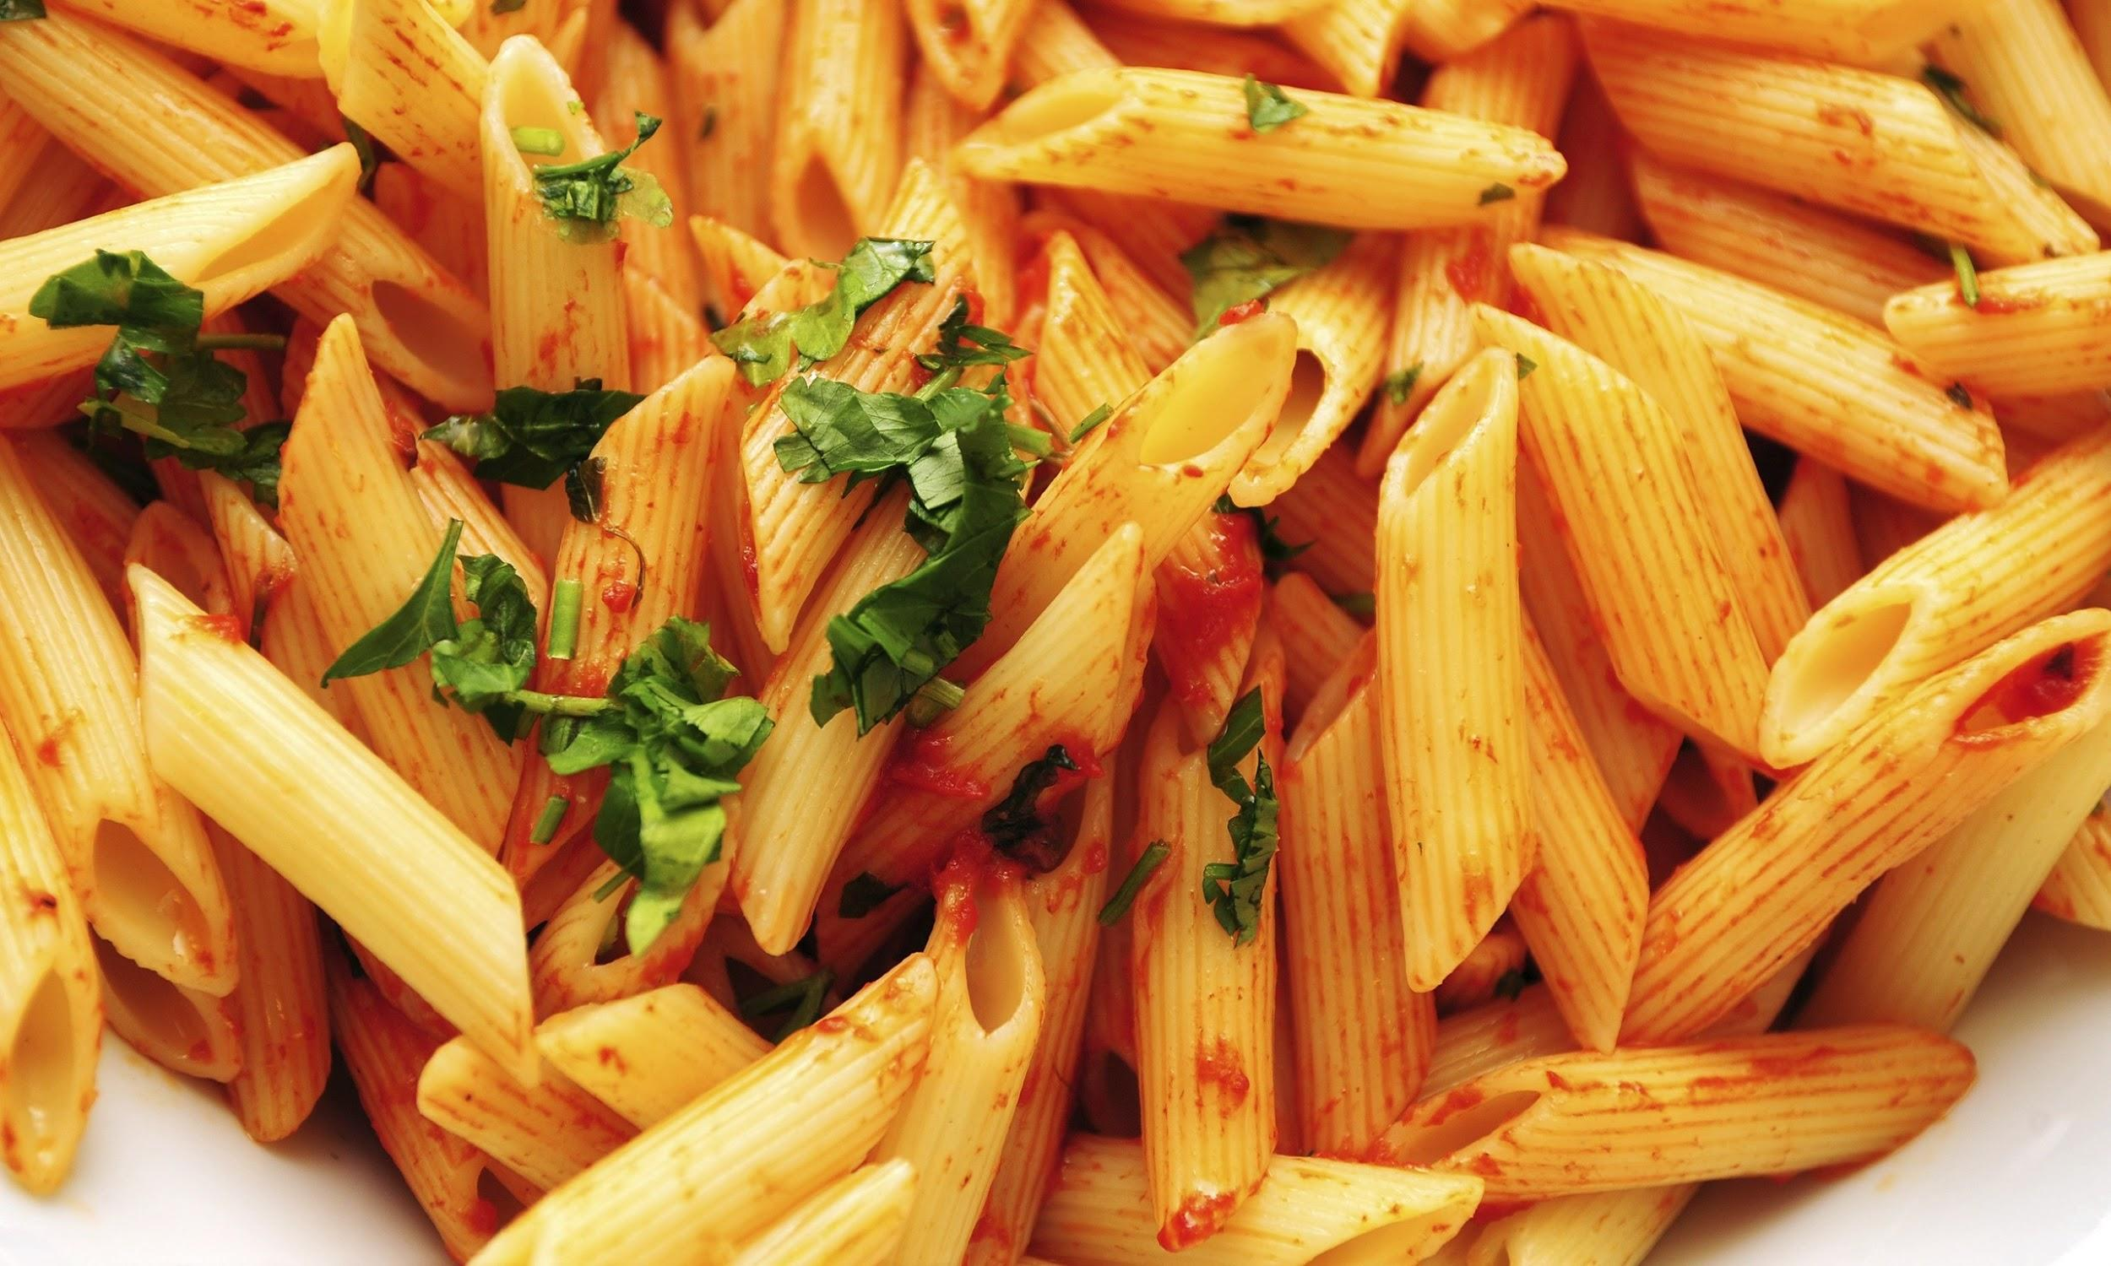
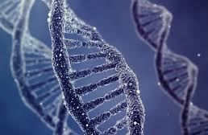
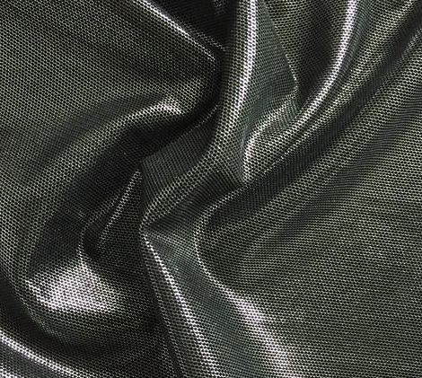
Monomers are small molecules that are able to join with other small molecules (sometimes the same, sometimes different) in a chain to form very long molecules, often with special properties. These are called polymers.
Polymers
Notes:
Polymers

Slide 10
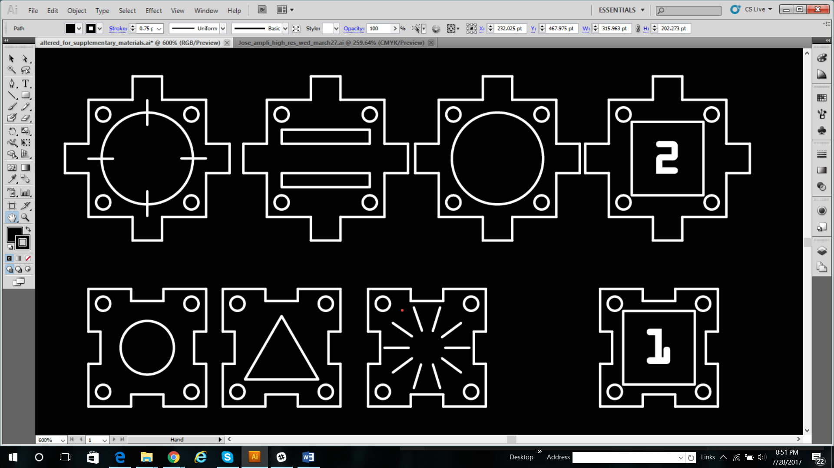
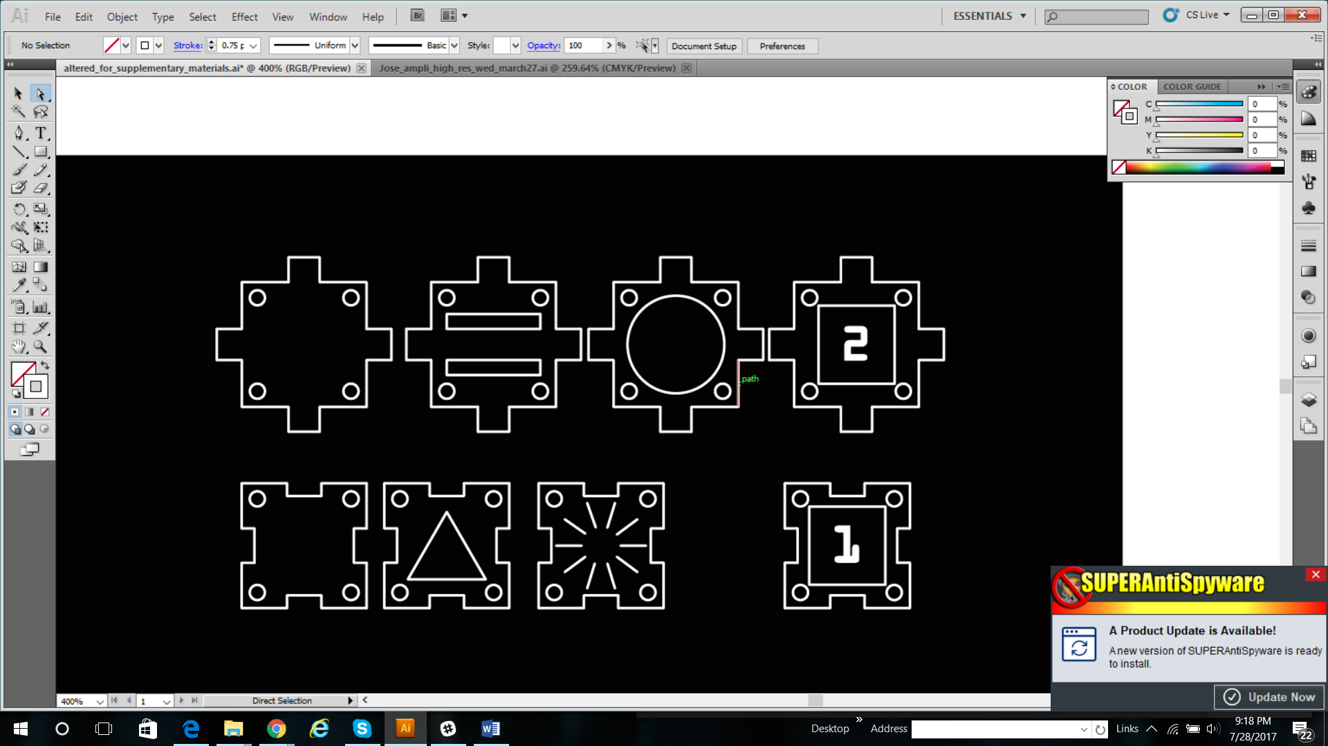
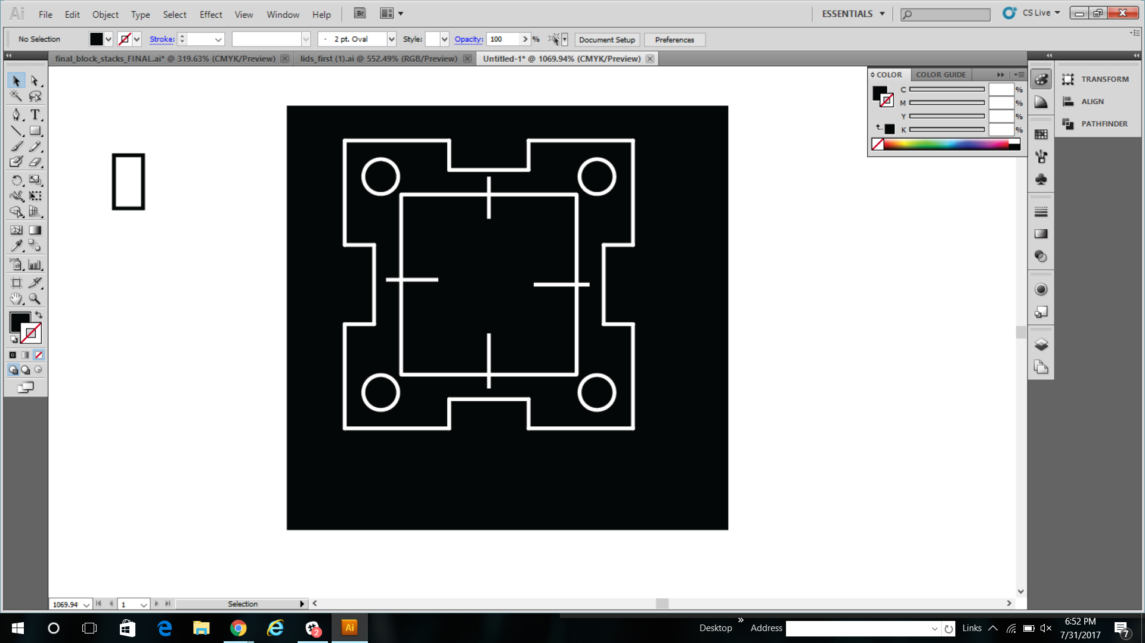
Chemical Circuit Design: Nylon synthesis!
Pipette block (hole
In the lid!!)
Adipic Acid
HMDA
Blank
Gold
Nanoparticles
Notes:
Nylon rxn info

Slide 11
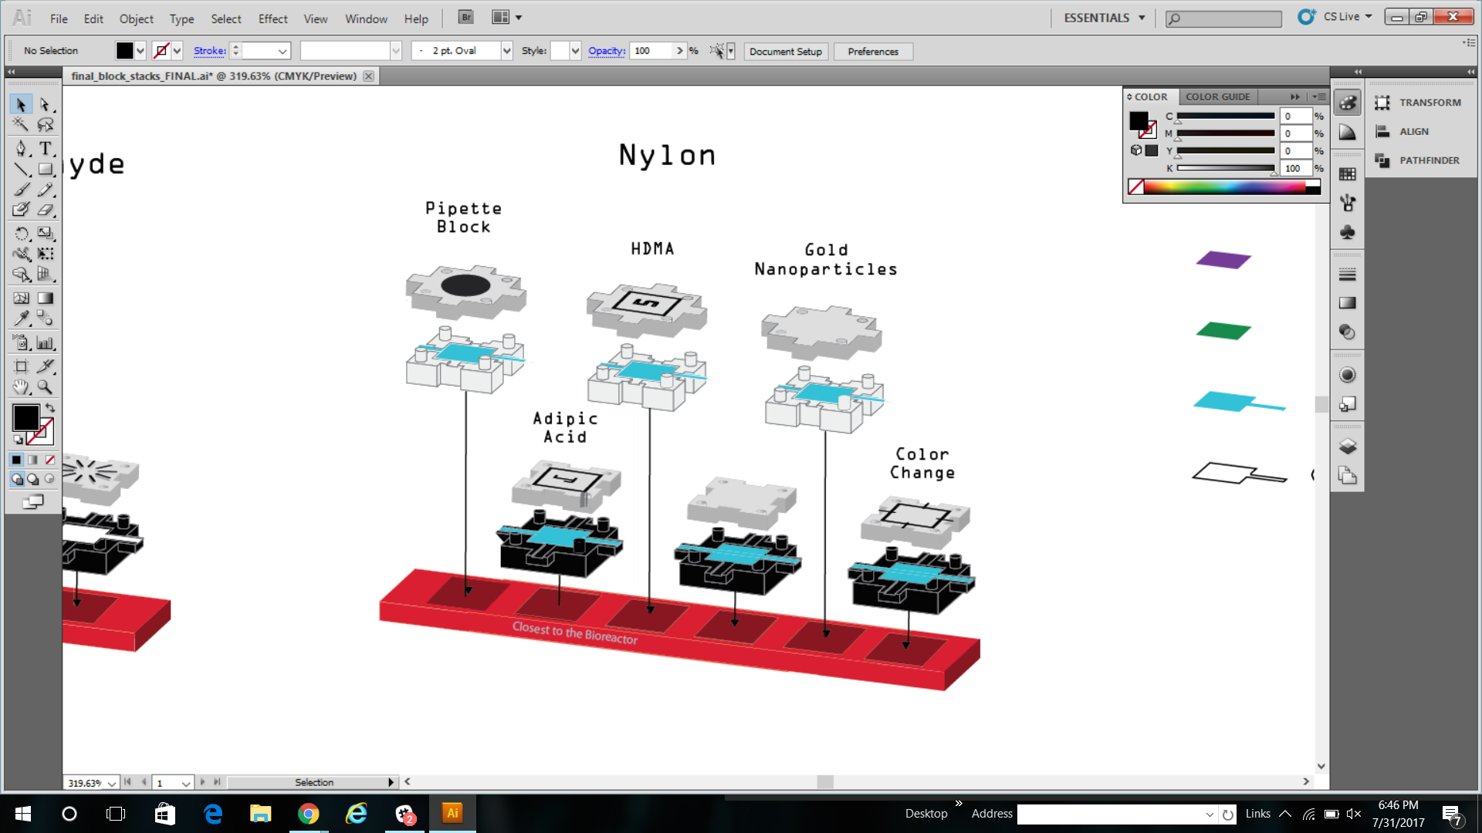
Blank: pipette block (hole
In the lid!!)
Adipic acid
HMDA
Blank
Gold Nanoparticles
Color change

Slide 12
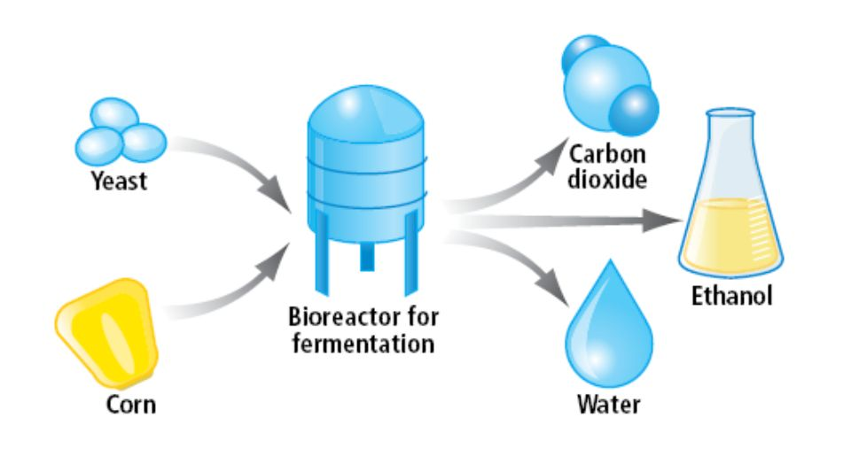
In a typical plant, we need to connect the fermentation tanks, with other tanks that collect useful products
Notes:
http://slideplayer.biz.tr/slide/10943534/

Slide 13
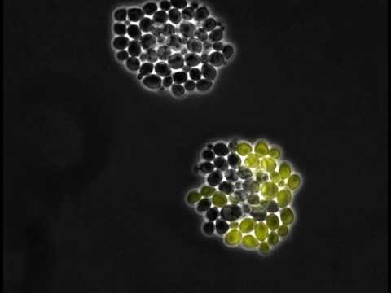
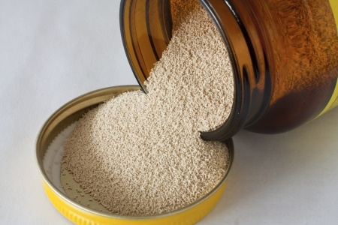
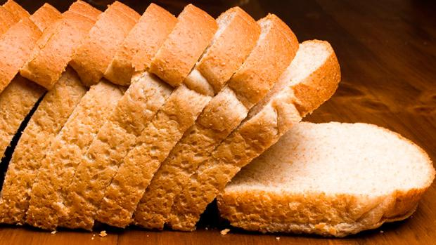
Yeast are single-celled microorganisms that you might commonly find in both labs and kitchens
Notes:
Bread pic: https://www.t-nation.com/diet-fat-loss/the-truth-about-bread

Slide 14
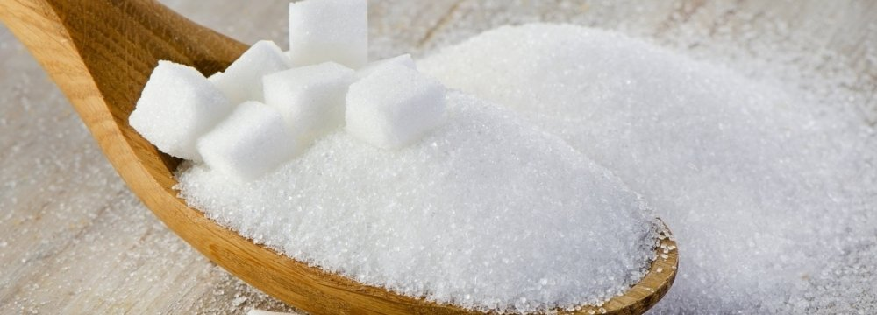
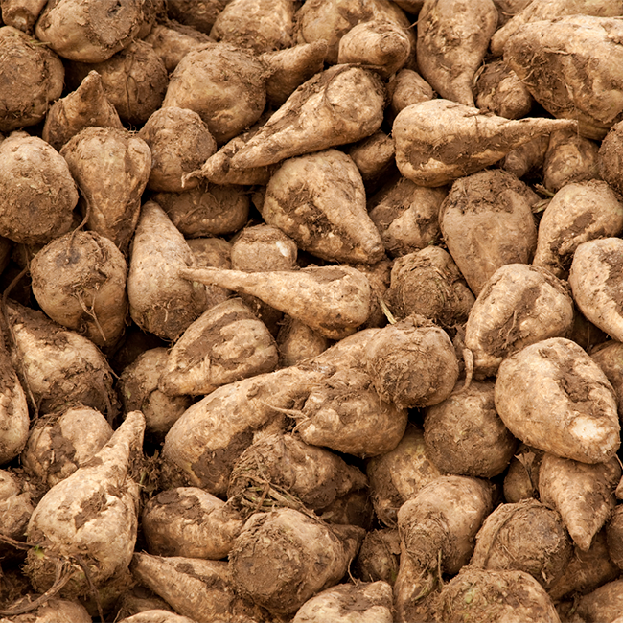
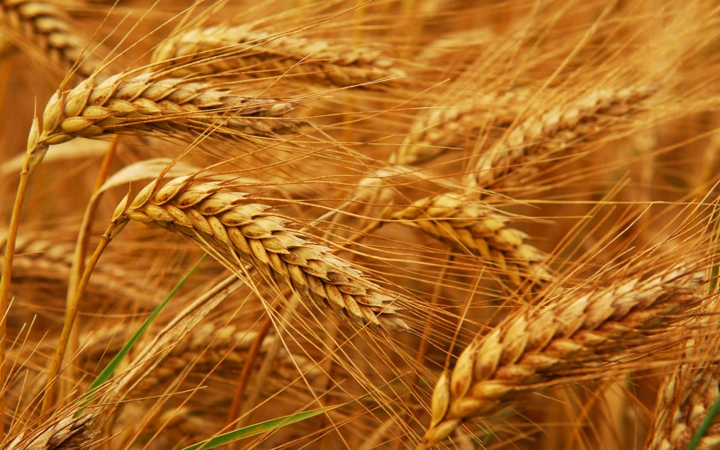
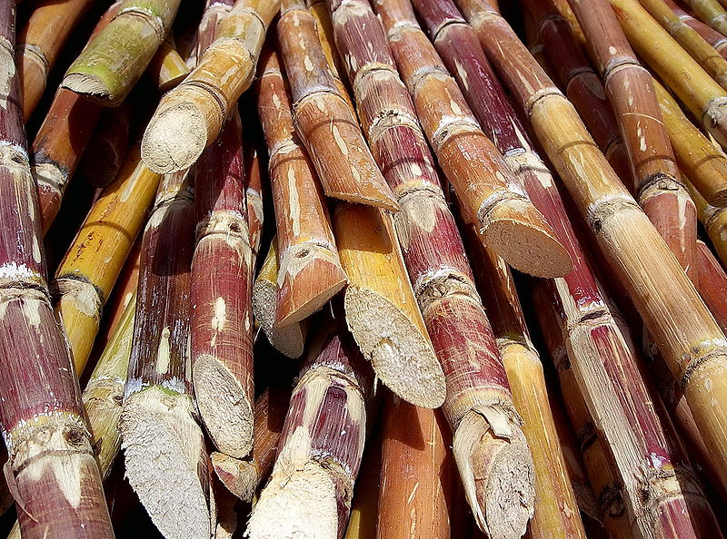
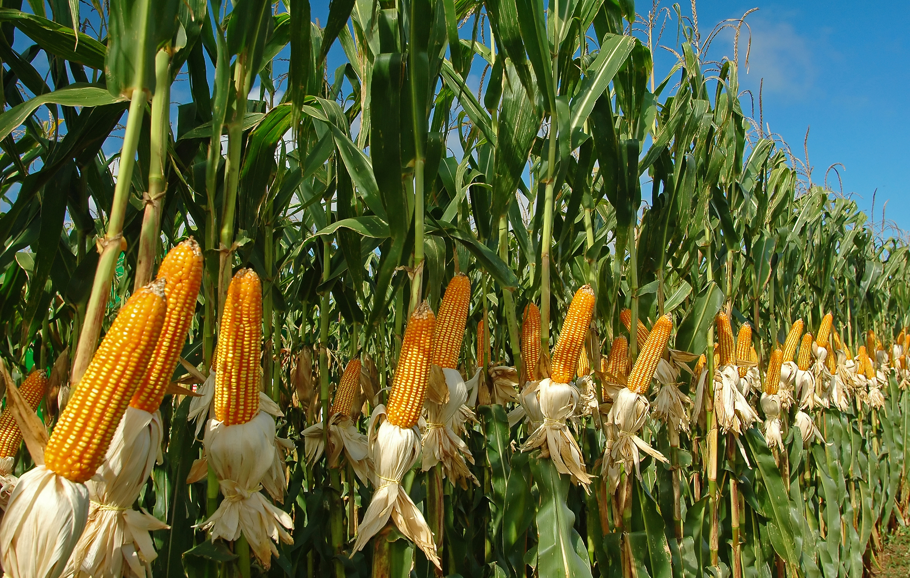
Yeast consume sugars (everything from wheat, barley, rice, and corn, to lab glucose)
Notes:
Images: http://www.weightzonefactor.com/blog/why-whole-wheat-bread-is-not-healthier-than-white/, https://financialtribune.com/articles/economy-domestic-economy/63081/gov-t-slashes-sugar-import-tariffs

Slide 15
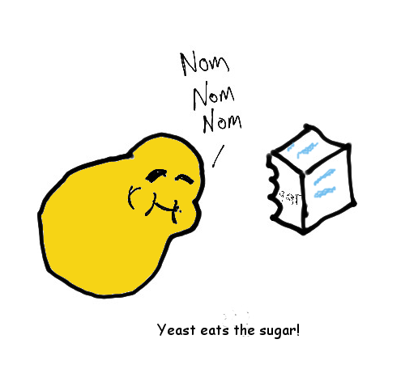
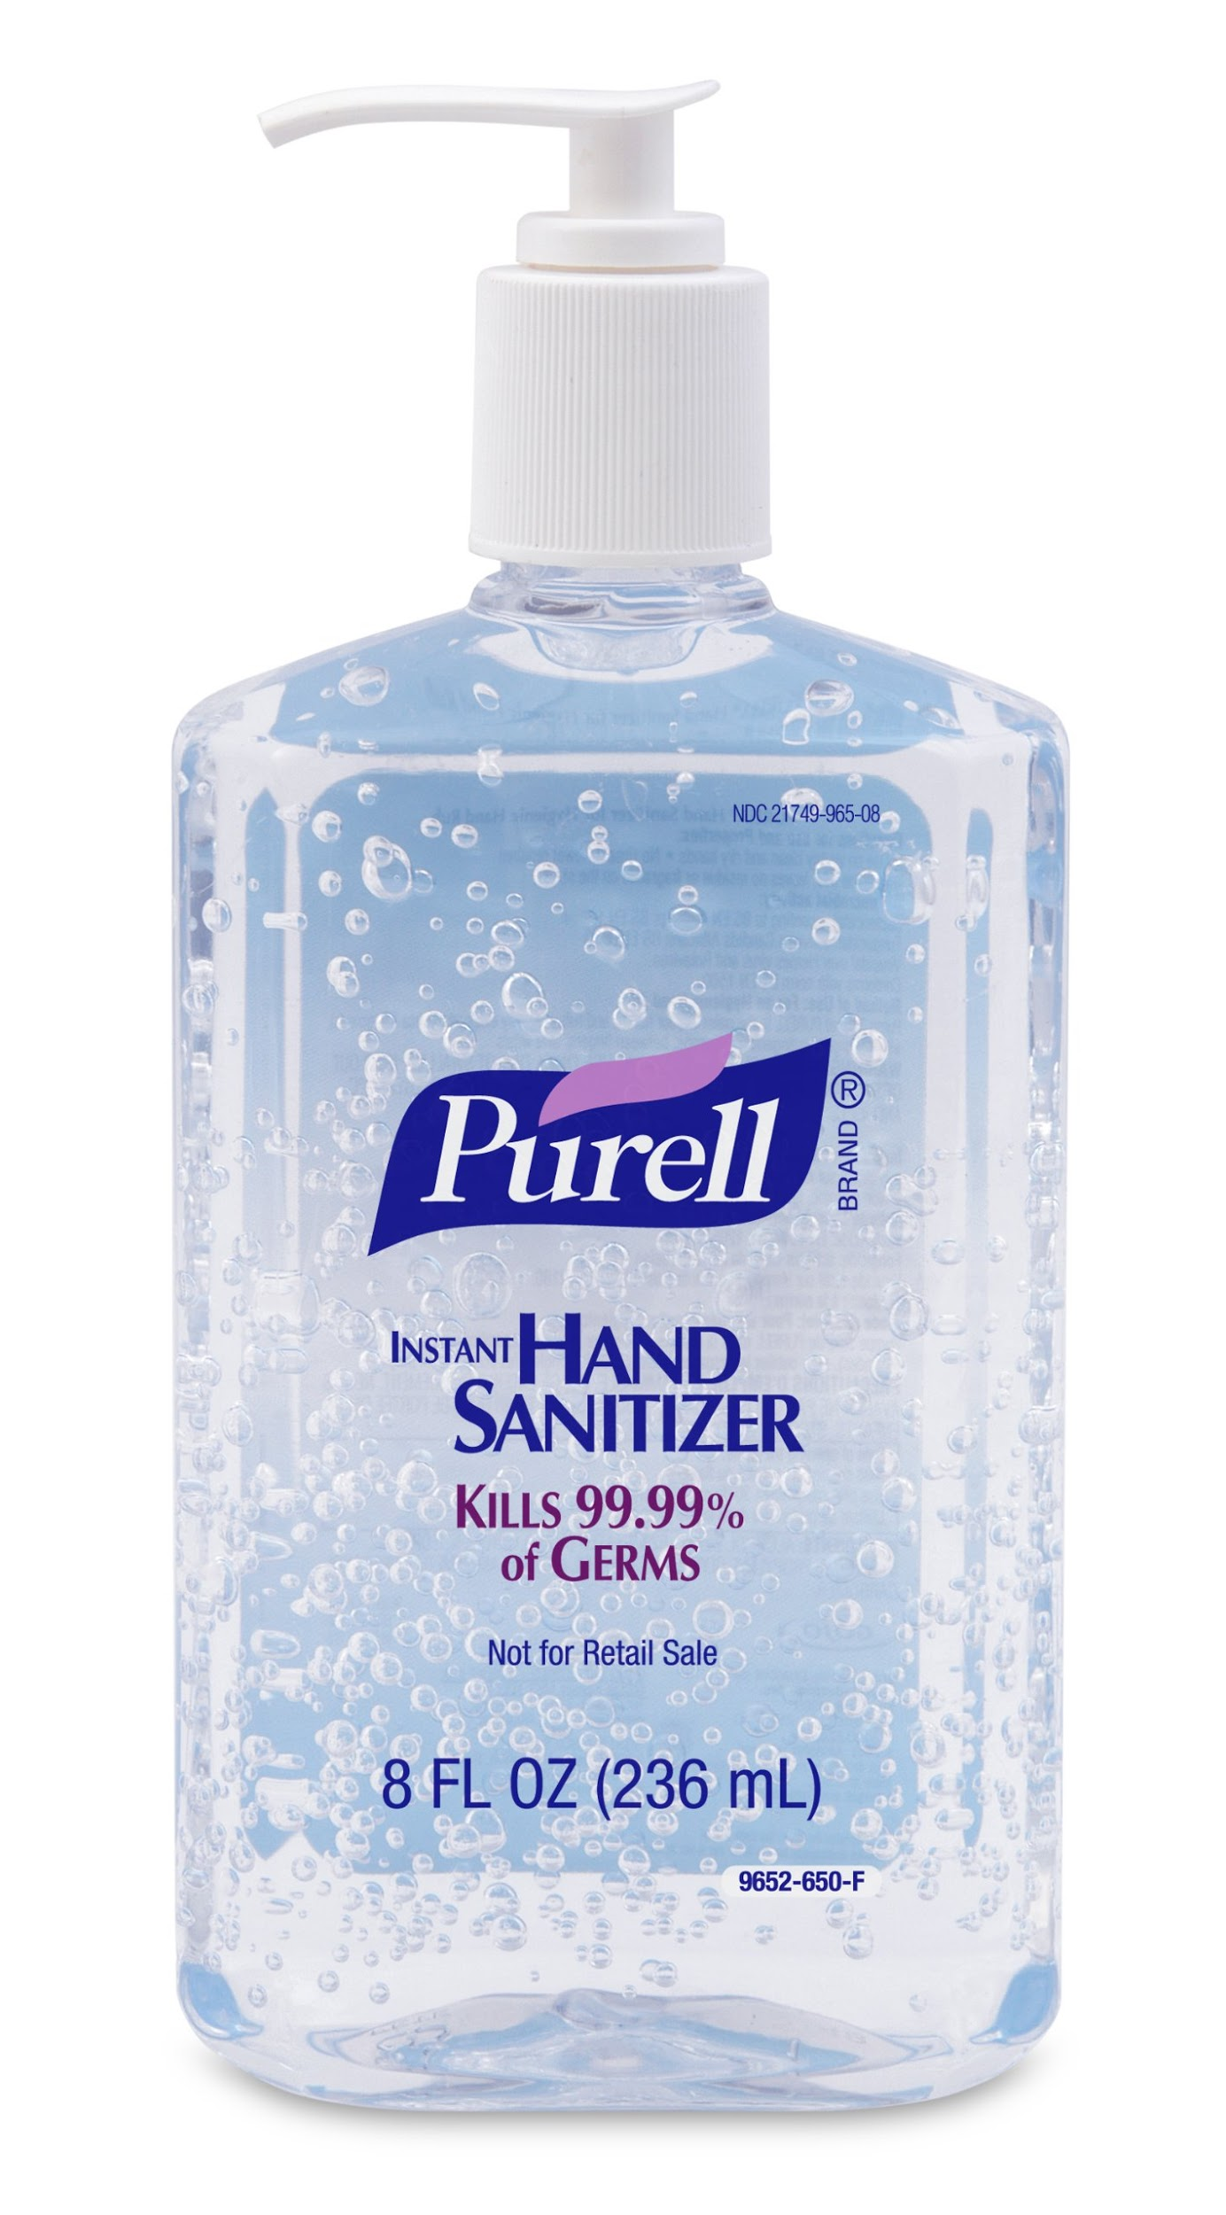
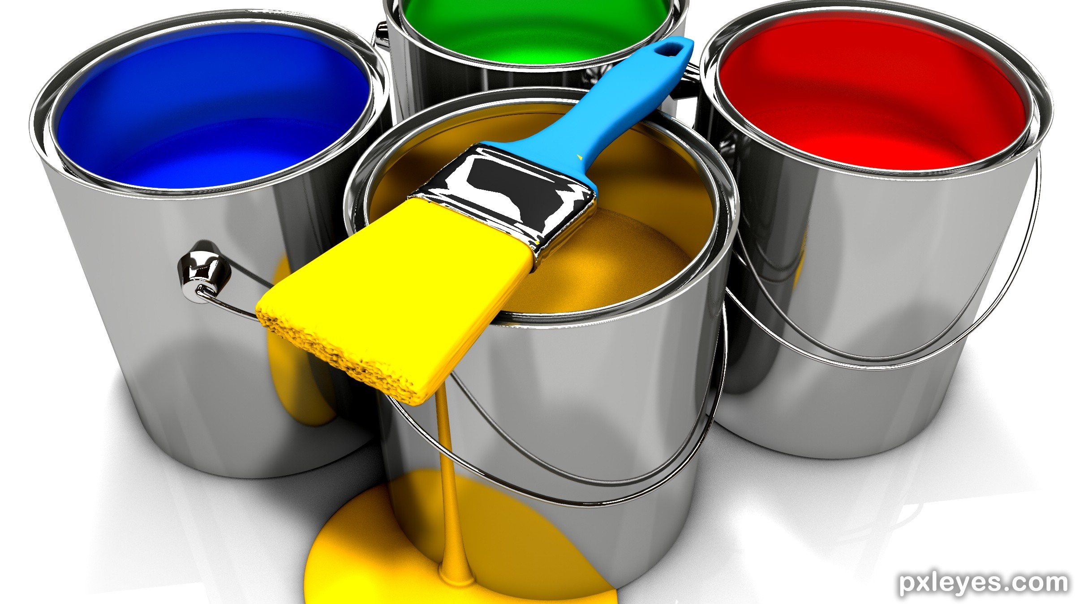
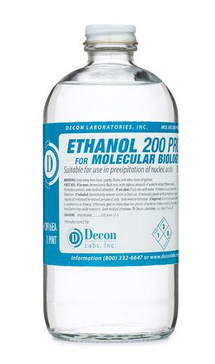
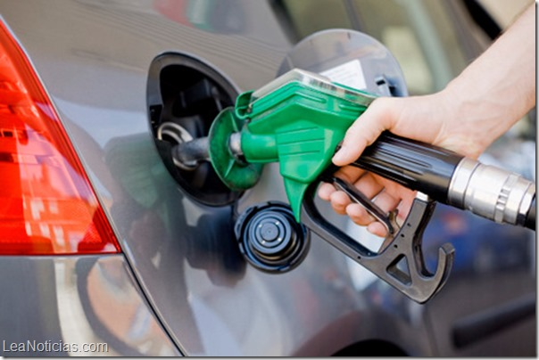

When yeast eat sugar, we call that fermentation and it can produce useful products: CO2 and Ethanol
Notes:
Image credits: http://bigmeankitty.com/fp/wp-content/uploads/2016/05/Alcohol.jpg, http://www.pxleyes.com/3D-contest/21149/brush-up-your-3D.html, http://deconlabs.com/products/molecular-biology-ethanol/,

Slide 16
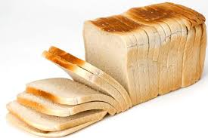
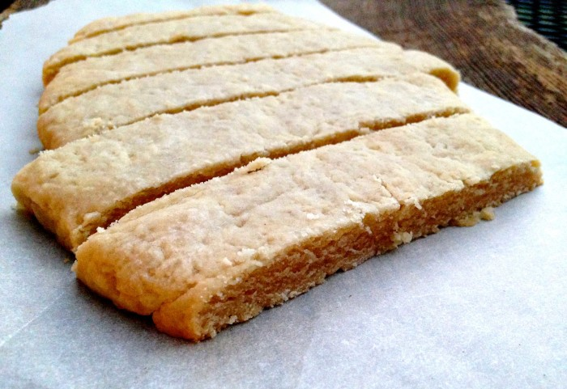
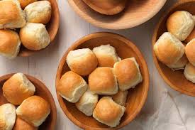

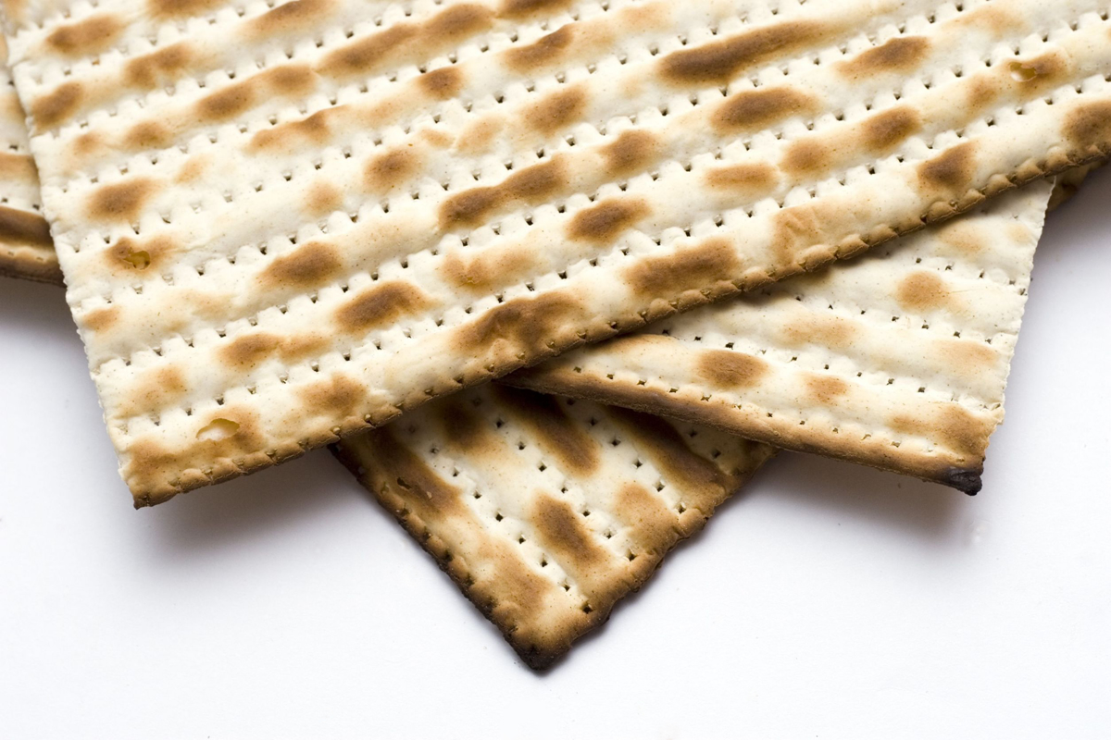
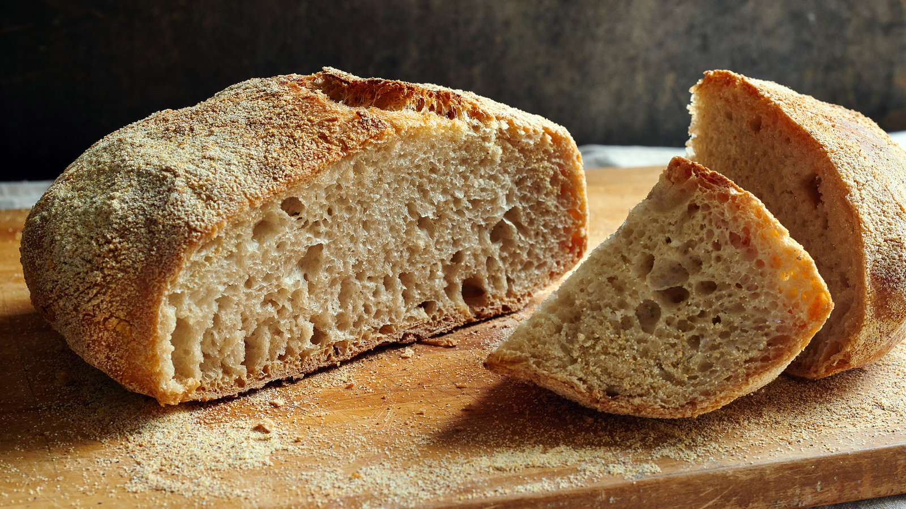
Leavened
Unleavened
Yeast and Bread
Yeast eats sugar and releases carbon dioxide and alcohol.
Yeast contains enzymes that help to break down bread ingredients into simple sugars that the yeast can eat. The air bubbles found in leavened bread are from alcohol and CO2 that is produced when yeast eats these simple sugars.
Notes:
http://www.finecooking.com/article/yeasts-crucial-roles-in-breadbaking

Slide 17
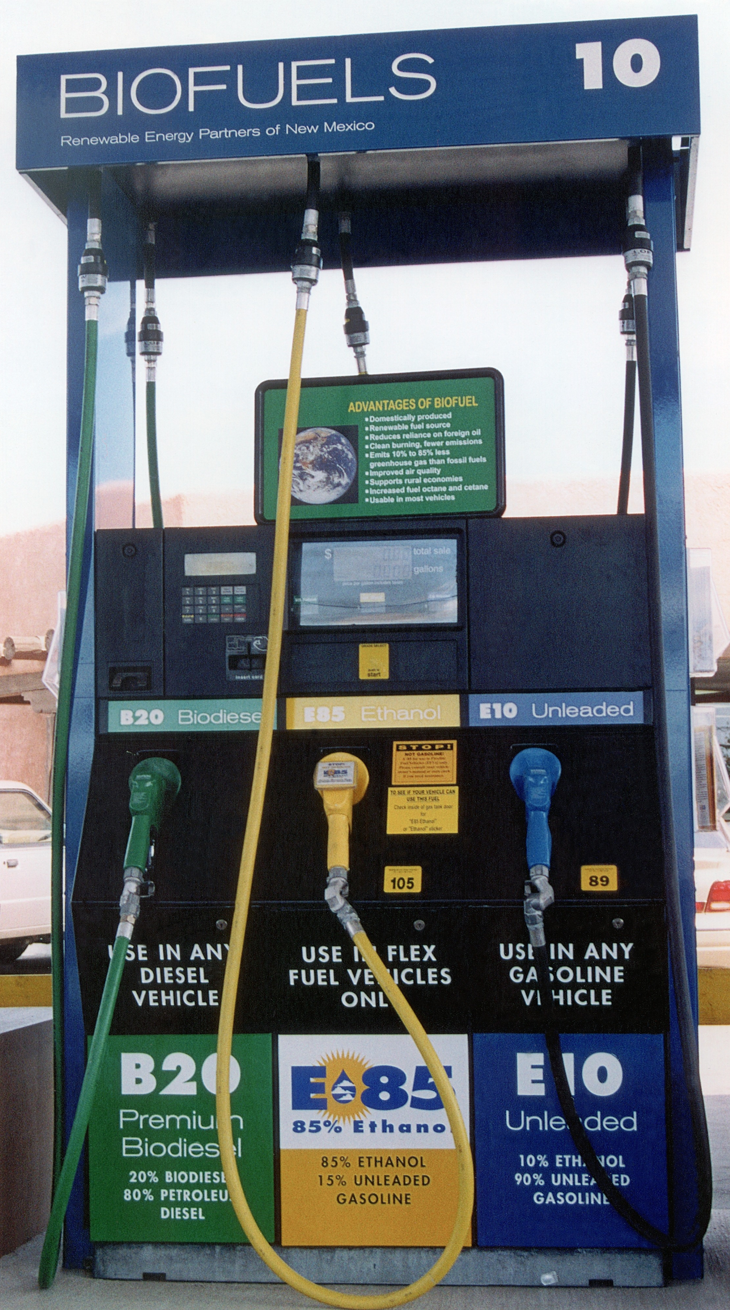
Ethanol as a Biofuel
Ethanol is made from biomass (plant materials) and today is present in upwards of 97% of U.S. gasoline where it helps to reduce air pollution and serves to oxygenate the gasoline
Most of the ethanol produced in the US is made from corn grain and it has a positive energy balance
A positive energy balance is when the sum total of the energy that went into the corn and the fuel production is less than the total energy contained in the fuel

Slide 18
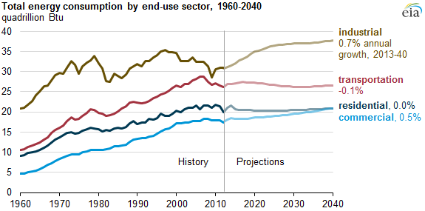
Energy Demand
Source: U.S. Energy Information Administration
Notes:
https://www.eia.gov/todayinenergy/detail.php?id=21012

Slide 19
What is Organic Chemistry?
Organic chemistry is….
The study of organic molecules, that is, the carbon-based molecules that make up living organisms (on this planet)
The discipline also involves organic synthesis…
The study of how to build complex organic molecules from starting materials with very few carbons, by substituting various small structural subgroups, called “functional groups”, for one another.
Notes:
Organic chemistry

Slide 20
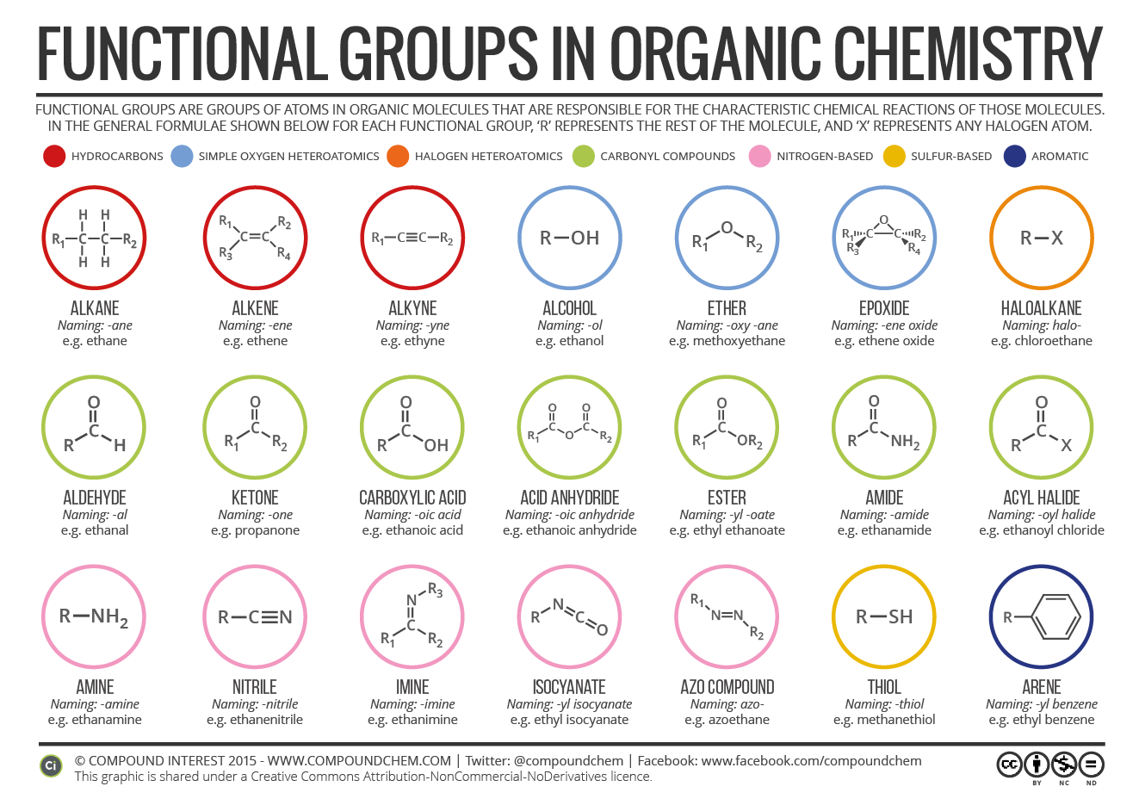
For instance, you can add carbon-oxygen bonds to ethanol to make other functional groups: aldehydes and carboxylic acids!

Slide 21
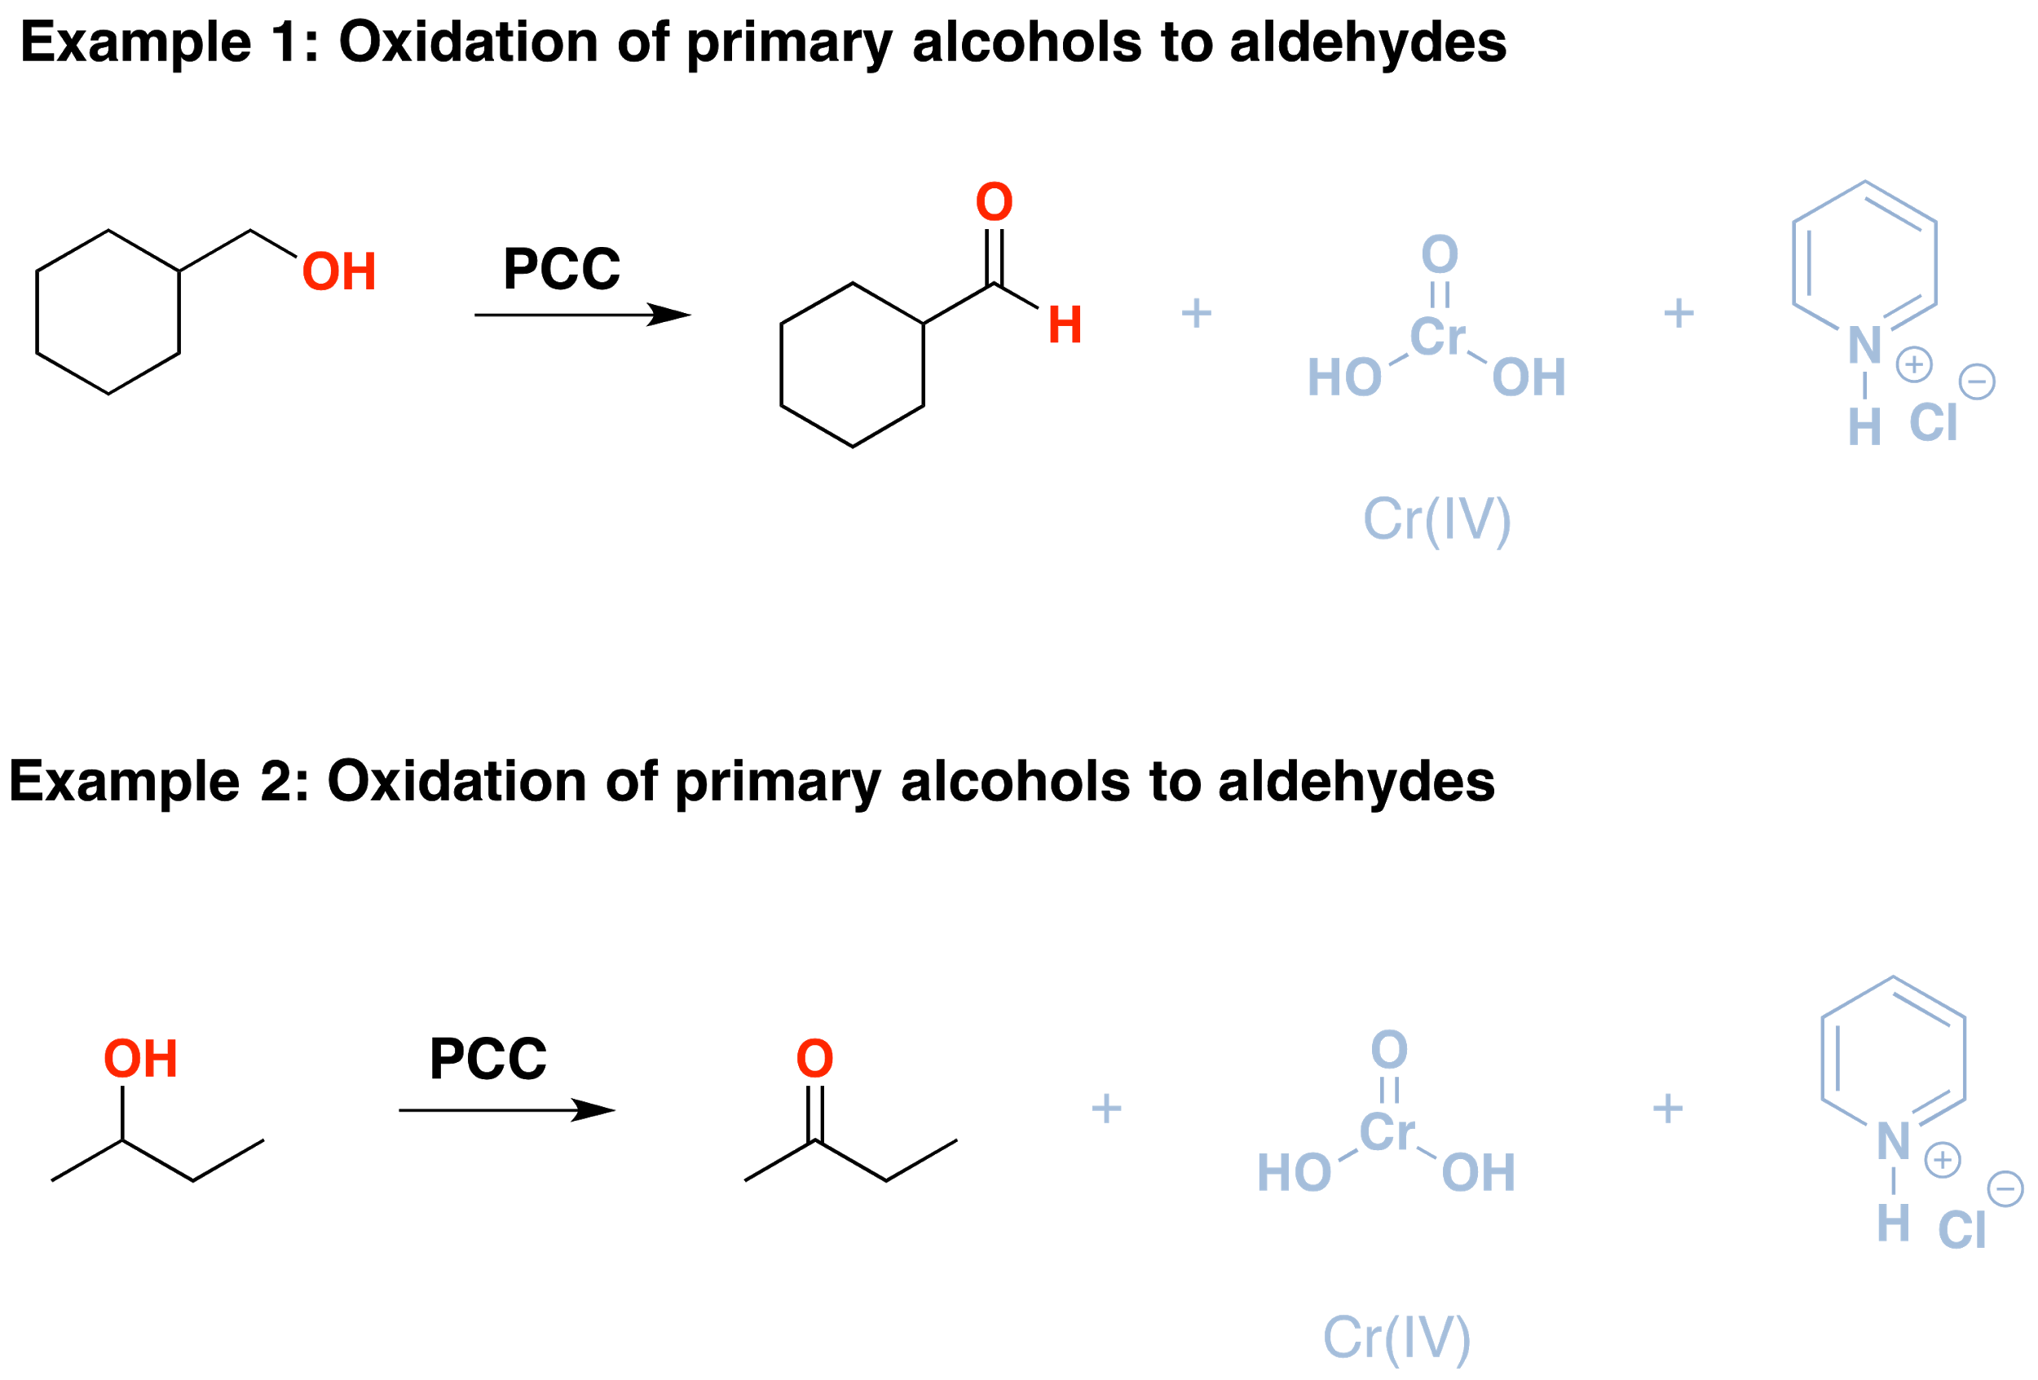
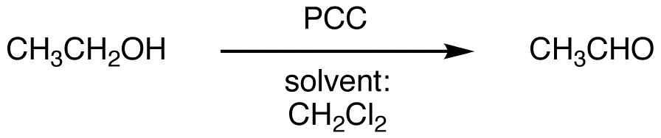
Today we will use Ethanol as a starting material.
For us, it will look like this….
Notes:
Rxn overviews

Slide 22
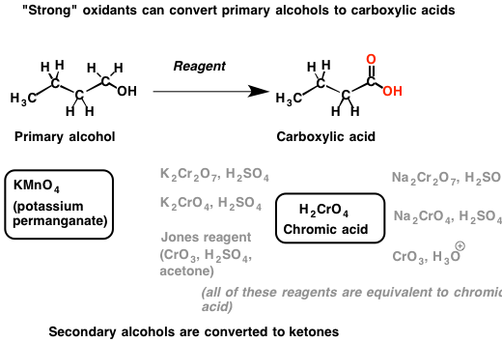
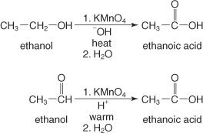
Today we will use Ethanol as a starting material.
For us, it will look like this….
Notes:
Rxn overviews

Slide 23
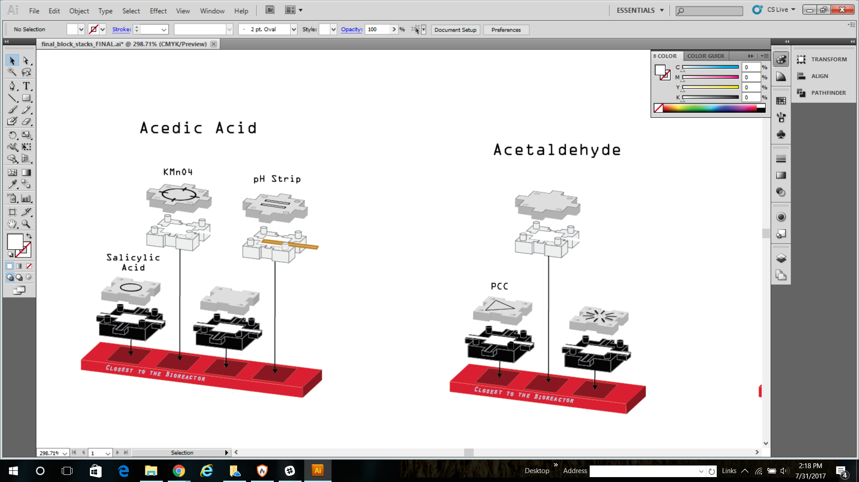
Salicylic Acid
OR dilute strong acid
KMNO4
Blank
Prepare:
pH strip
PCC
Blank
Blank
Notes:
Rxn instructions

